Slide 1
West Nile Virus Prediction
Presented by Mayra Chavez

Slide 2
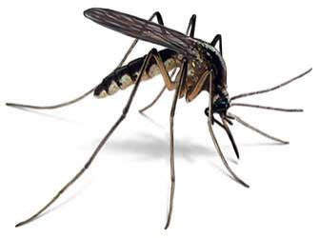
West Nile Virus
Leading cause of mosquito-born disease in the U.S.
1 in 50 infected people develop a fever and other symptoms.
1 in 150 infected people develop serious, sometimes fatal, illness.

Slide 3

Problem Statement
When and where will different species of mosquitos test positive for the West Nile Virus in the City of Chicago?

Slide 4

Data Overview
Weather: Contains different weather conditions collected from Station 1 and Station 2
Incomplete data
Missing values
Null values
Training: Contains traps, their location, mosquitos trapped, and if they tested +/- for WNV.
Complete data

Slide 5
Data Cleaning & Feature Engineering
Approaches taken to clean data:
Deletion
Imputing with:
Average
Median
Ffill()
TimeSeries
Added features to:
Shift weather data 1-day
Shift weather data 2-days
Include relative humidity calculation
One-hot encoding of Species
Dates broken-out by:
Month
Week
Day of Month
Day of Week
Year
Season

Slide 6
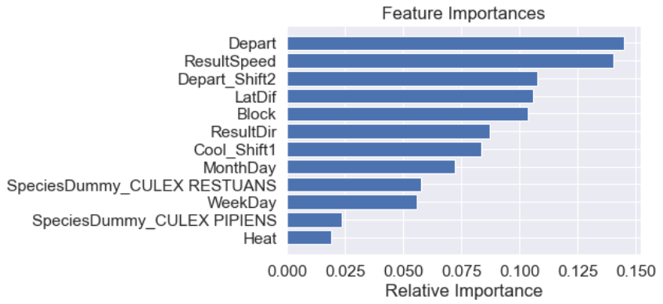
Feature Selection and Reduction
Selected features with Informative Value (IV)
Further reduced features with Variance Inflation Factor
Final Features

Slide 7
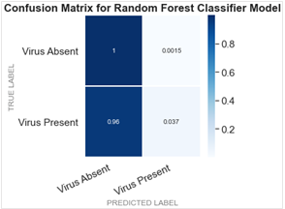
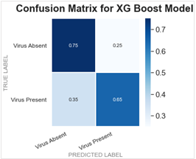
Model Selection
Random Classifier - AUC 0.51
XG Boost Model - AUC 0.70

Slide 8
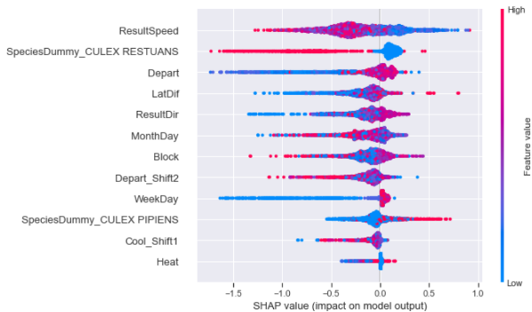
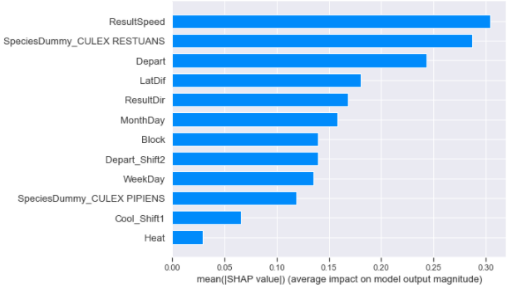
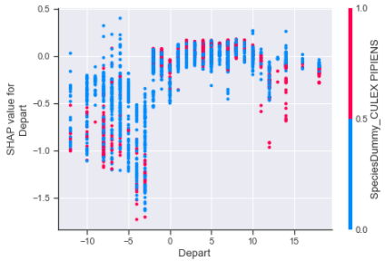
SHAP Value Analysis
Feature Importance
Feature impact on prediction of West Nile Virus presence

Slide 9
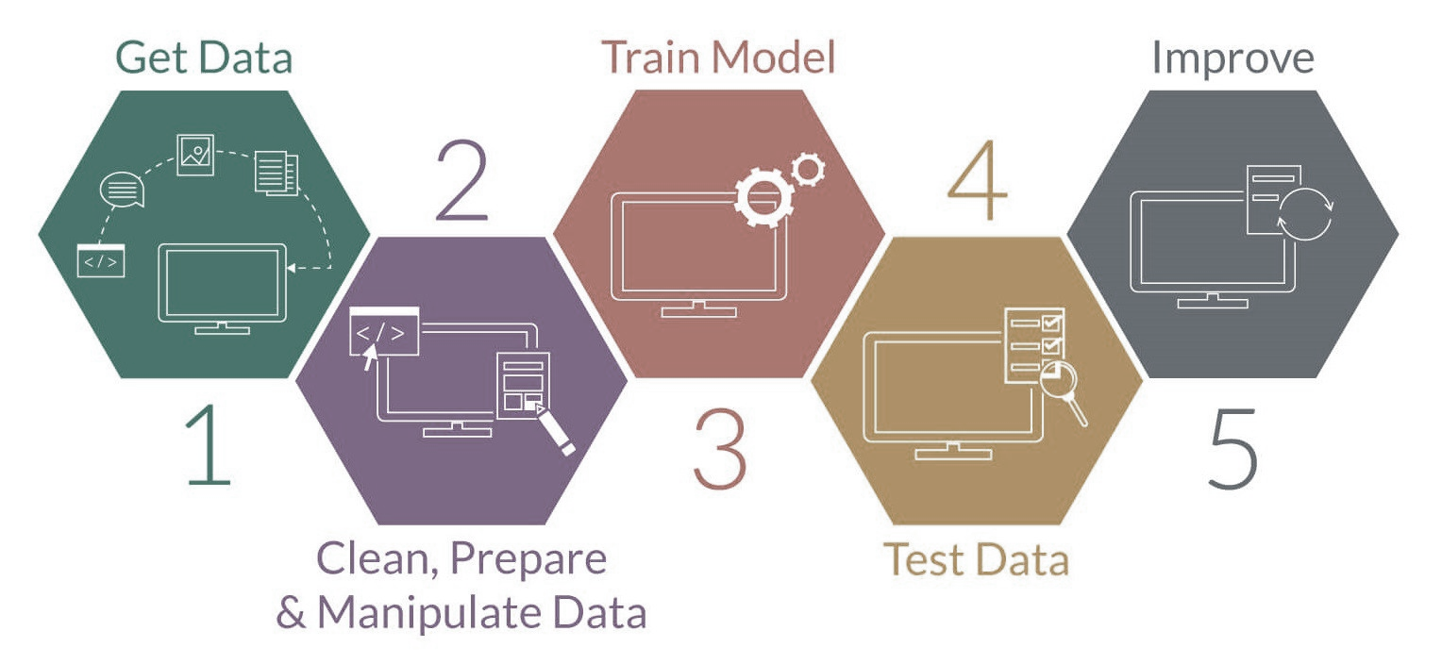
Conclusion
Predictive power of model to explain when and where.
Model weaknesses.
Ways to improve model.

